Slide 1
Energy communities in EU energy policy
Achille Hannoset, European Commission, DG ENER, Unit B1

Slide 2
Clean Energy Package

Slide 3
Purpose of empowering consumers
Can be an effective tool to increase public acceptance of new projects
Mobilise private capital for the energy transition
Could be a tool to increase flexibility in the market
Transform consumers into energy citizens by involving them actively in energy decision-making

Slide 4
Consumer empowerment
Individual active customer
Jointly acting active customers
Energy communities

Slide 5
Shared core
Citizen Energy Communities (CEC)
Renewable Energy Communities (REC)
CEC
REC
Renewable electricity market
Any legal entity
Open and voluntary
Primary purpose to provide environmental, economic or social community benefits

Slide 6
Differences between REC and CEC
CEC
Electricity (technology-neutral)
Any entity may participate
REC
RE based heating and electricity
Natural persons, local authorities, or small enterprises in effective control
Participants located in the proximity of the renewable energy projects that are owned and developed by REC
Limited to natural persons, local authorities or SMEs (participation ≠ primary activity)
“Autonomous”
No decision-making power for large energy companies
Open to low-income and vulnerable households

Slide 7
Enabling framework REC & CEC
Privileges:
Access to financial instruments and information
Customised support scheme
Removal unjustified barriers
Regulatory and capacity-building support to public authorities
Rights and responsibilities:
facilitating market integration (procedures, tariffs and activities)
REC
REC + CEC

Slide 8
REPowerEU

Slide 9
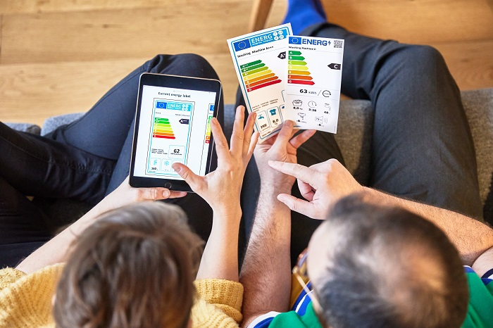
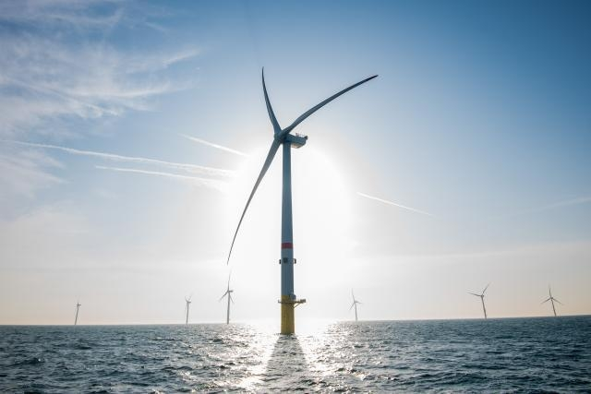
Role of citizens and communities under REPowerEU
Communities and citizens can help to deliver on two out of three objectives of REPowerEU:
Produce clean energy by increasing acceptance and mobilising private capital investments
Save energy by providing energy efficiency services to their members and increasing consumer consciousness of energy use
Self-consumption schemes may help to secure access to affordable energy, including for low-income households
x

Slide 10
Key REPowerEU policy instruments
Legal proposals
EU Save Energy Communication with recommendations for how citizens and businesses can help save around 13bcm of gas imports in the short term
EU Solar Strategy with measures to accelerate the roll out of solar energy to increase capacity to 600 GW by 2030
Electricity market design Communication to accelerate energy transition and ensure access to low-cost renewables
Biomethane Action Plan to save up to 35 bcm of natural gas by 2030
Permitting Recommendation to simplify and ease permit granting, grid connection and production licensing procedures
Energy Performance of Building Directive (EPBD)
Electricity Market Directive
Gas Market Directive
Renewable Energy Directive

Slide 11
EU objectives and actions under EU Solar Strategy
Energy communities facility by 2024
At least one renewables-based energy community in every municipality with a population higher than 10 000 by 2025
Mandatory installation of rooftop solar energy for all public buildings (> 250m²) by 2027 and new residential buildings by 2029

Slide 12
Member State actions for energy communities
Lack of time, financing and technical expertise
Make use of flexibility provided by State Aid Guidelines
Assess and remove unjustified barriers
Simplify and ease licensing and permitting procedures
Integrated One-Stop-Shops to facilitate access to financing and information

Slide 13
3. EU Initiatives

Slide 14
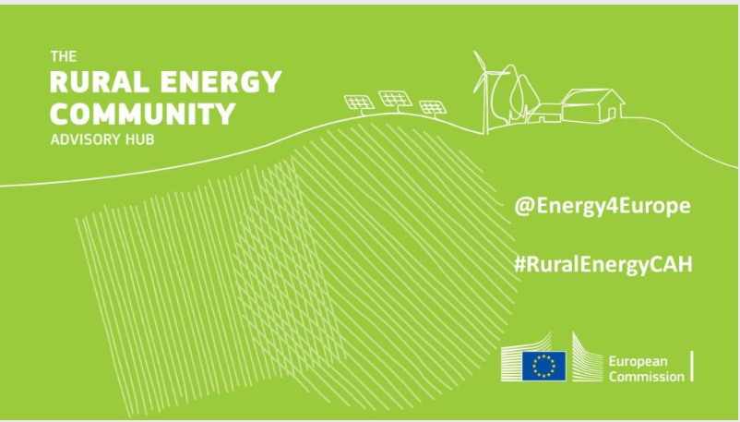
Rural Energy Community Advisory Hub (RECAH) – end of 2023
Best practices
Guidance documents
Technical assistance (closed)
Building a network

Slide 15
Energy Communities Repository – end of 2023
Emerging good practices
Technical assistance (closed)
Barriers and action drivers report
Impact assessment
Repository of cases and legal developments

Slide 16
4. Reform Electricity Market Design – Energy sharing models for consumer empowerment

Slide 17
Background & Objective
High & volatile energy prices have impacted the electricity bills of consumers
Direct access to RES can help decouple the electricity bill from volatile wholesale market prices and dampen their impact
Not all consumers have direct access to RES due to spatial or financial constraints.
Energy sharing facilitates direct access to RES generated or stored off-site.

Slide 18
Model 1: Sharing of energy generated or stored by a facility that is collectively owned, leased or rented
Jointly invest in RES capacity
Option 1
Energy community according to EU definitions
Legal entity or private agreements
Jointly invest, lease or rent RES capacity
Option 2
Prosumers
Share energy within certain time interval (against a service fee) & within the same bidding zone

Slide 19
Model 2: Sharing of excess energy generated or stored by a facility of an individual prosumer with other consumers
Share energy within certain time interval free of charge or against a price/kWh within the same bidding zone (directly or through third party facilitator)
Excess production
Self-consumption
Consumers
Prosumer

Slide 20
Keep in touch
ec.europa.eu/
europeancommission
europa.eu/
@EuropeanCommission
@EU_Commission
EUTube
@EuropeanCommission
EU Spotify
European Commission

Slide 21
Thank you
© European Union 2020
Unless otherwise noted the reuse of this presentation is authorised under the CC BY 4.0 license. For any use or reproduction of elements that are not owned by the EU, permission may need to be sought directly from the respective right holders.
Slide xx: element concerned, source: e.g. Fotolia.com; Slide xx: element concerned, source: e.g. iStock.com

